Slide 1
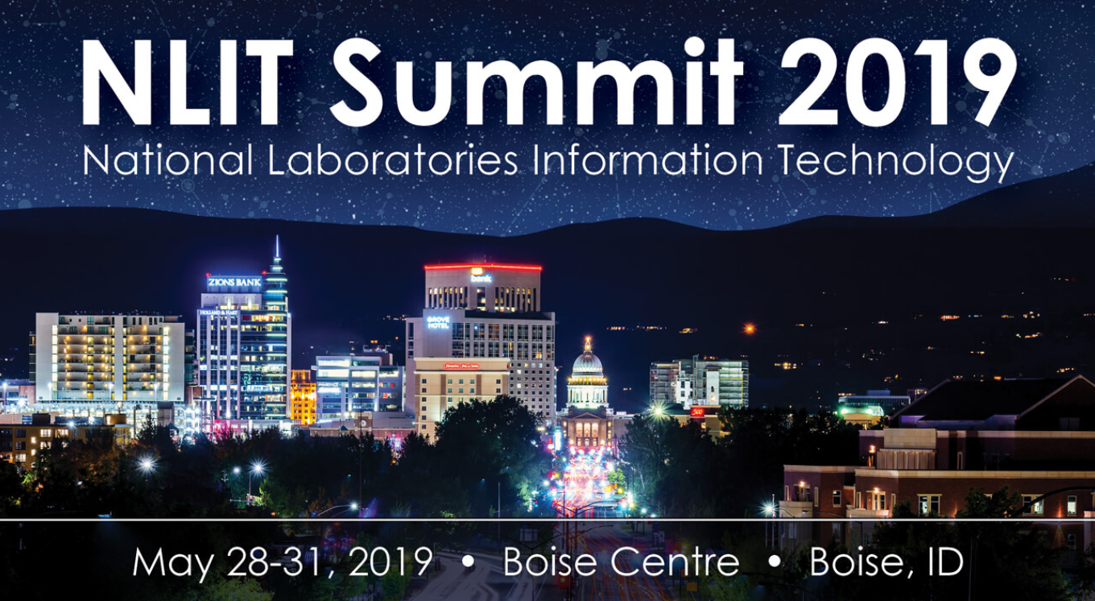
Sandia Insights A Data Architecture and Framework
Larry Arellano and Patrick Carlson

Slide 2

Larry Arellano
Larry Arellano
lrarell@sandia.gov
My IT career was launched over 37 years ago. Today, I would call myself part architect, evangelist, and pioneer for realizing and productionizing Data Sciences at Sandia.

Slide 3
Roadmap – Our Data Sciences Journey
May 2015 - Sandia established a Data Sciences Department within the CIO’s Organization
Help institutionalize Data Sciences with the goal of better utilizing one of our most precious resources – “Our Data”
We had top level executive support who asked that we implement “game changing” technologies. This was the birth of our Infrastructure.
Developed the concept of Vetted/Raw/Integrated Datasets, Data Catalog, Integrated Visualizations and Analytic Applications which we bundled into an application named ASK (Analytics for Sandia Knowledge)
Data Central (serviced by a Data Virtualization engine)
Expertise Finder
Coauthor Network
Visualizations
Tableau Desktop and Tableau Server
Grown to multiple sites servicing multiple customers

Slide 4
Journey Continues
In 2017, we began to focus on building a team with a different vision that was centered around the following:
Data Engineering
Productionizing Machine Learning
Data Engineering is both the infrastructure and processes required to build automated Data Pipelines that support Metrics, Visualizations, Production Models, Cloud Pipelines, and Knowledge Research.
Productionizing Machine Learning is the infrastructure and tools required to create, push, and operationalize models in a living production environment. It is not the deployment of data-driven information into PowerPoint slides, but rather it is a living environment that deals with scale, speed, re-training, and presentation.

Slide 5
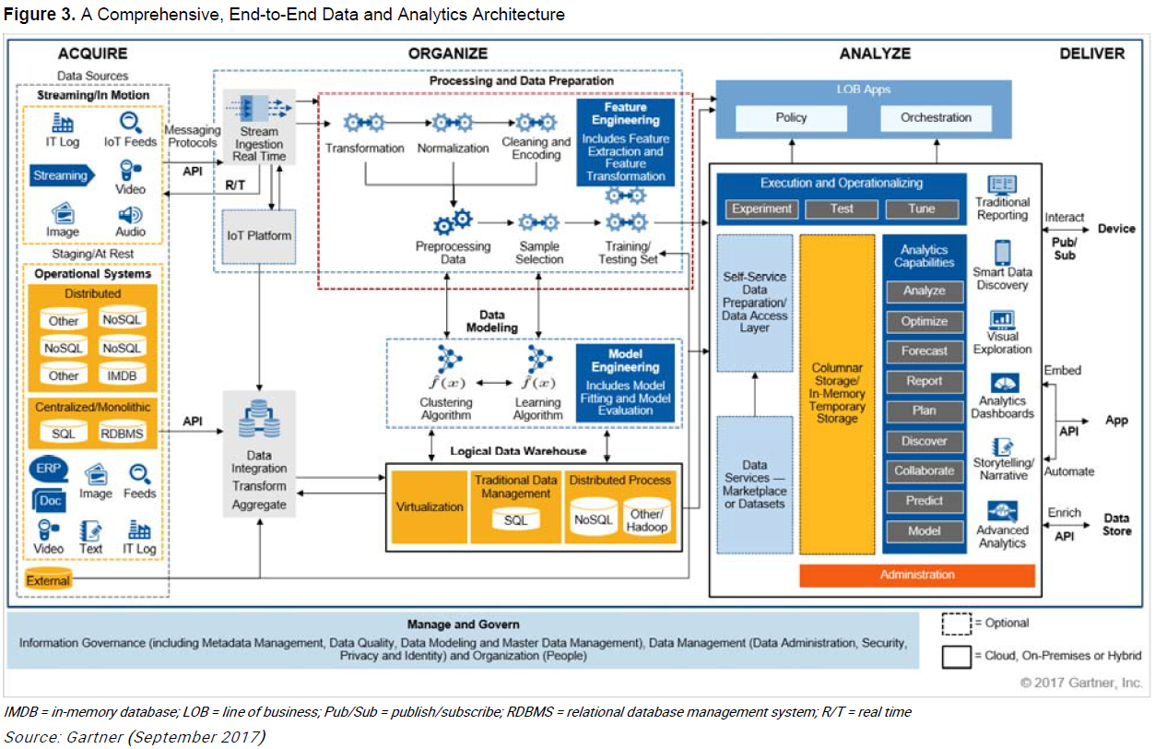
Research – Build a Reference Architecture
Sources:
Sandia experiences with ASK, BI Reporting, Analytic Modeling, Metrics and developing data pipelines required to support these activities
Interviews with Data Scientists / Data Analysts / Decision Makers
Gartner Research as a Reference Architecture (Comprehensive, End-to-End Data and Analytics Architecture)
Kaggle.com – competitions, community, online kernels / coding
CKAN sites – NETL EDX, data.gov, etc.
Goal:
Support each of these pillars (acquire, organize, analyze, deliver) within an integrated environment using a centralized application.

Slide 6
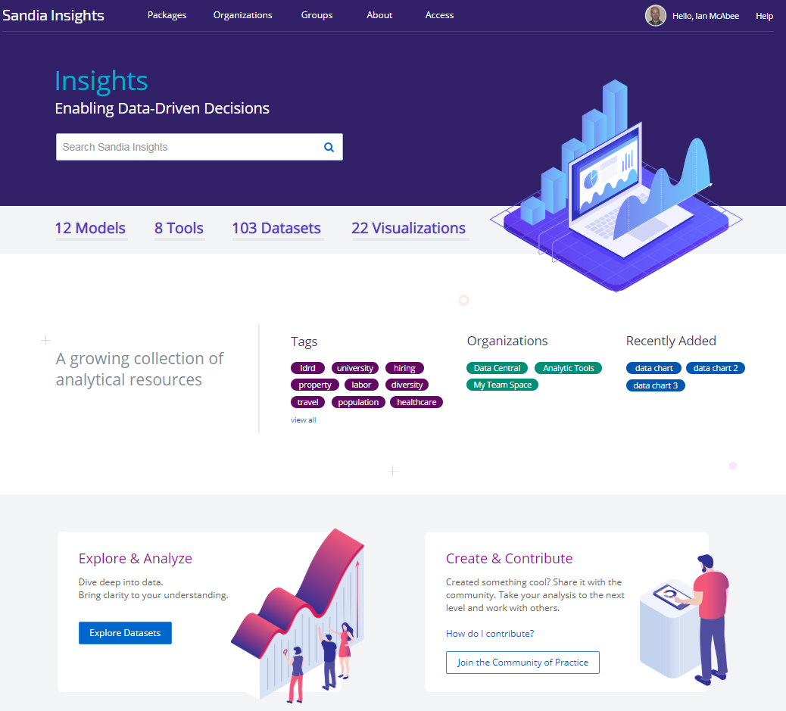

Today – Re-Evolution to “Sandia Insights”
Sandia Insights is becoming a living analytics architecture and framework that enables access to analytics data, models and visualizations; team collaboration tools for managing analytic studies; and a deep set of enterprise applications infrastructure. It is more than just a tool.
It is the overarching design of how we want to implement Data Sciences at Sandia.
At the heart of Sandia Insights is a powerful catalogue/data portal that makes data accessible – by providing tools to share, search, analyze, and use data.

Slide 7
Why – What do our customers need?
Rapid access to data that is easily joined (pipeline supplying data in minutes rather than months)
Eliminate duplication and rework (across data, analysis tools and models)
Data security and centralized catalog management via data governance
Robust data sciences tool chest (data prep, statistical analysis, algorithms, visualization, etc.)
Common environment with libraries to explore data and perform analysis
Infrastructure for heavy computation and model generation (scheduling and automation for model training/refresh)
Productionization of Machine Learning models and metrics/measures
Increased need to support Data-Driven decision making and visual management
Faster turnaround (from problem detection to problem solution)

Slide 8
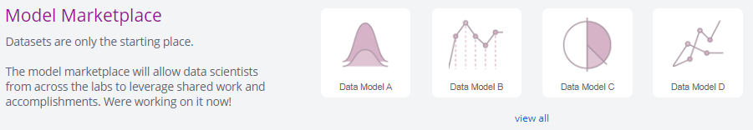
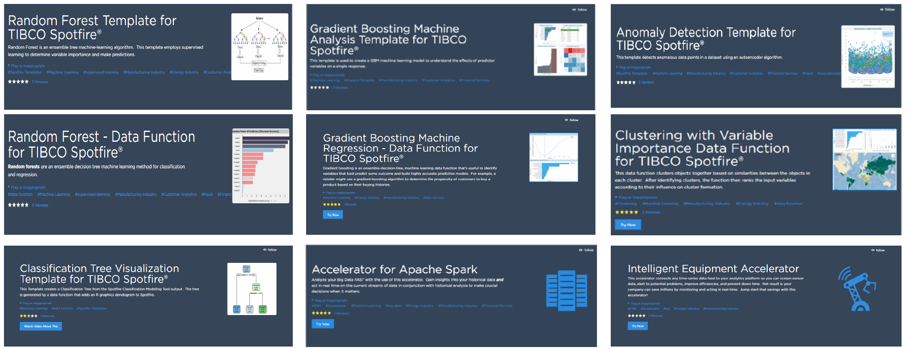
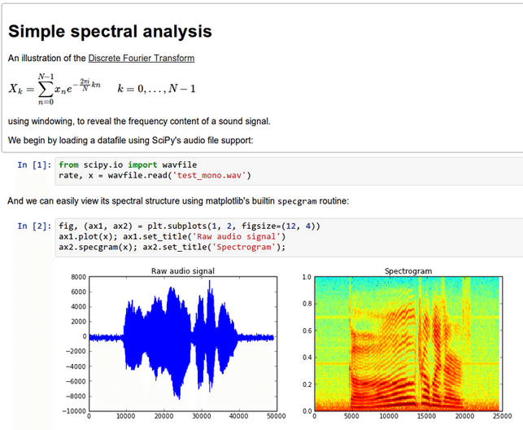
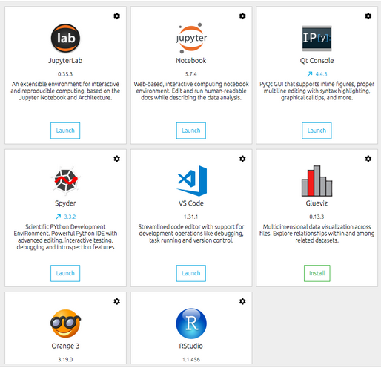
Sandia Insights Roadmap
Sandia Insights, when fully implemented, will contain these core capabilities:
Data Central / Catalog: An environment that provides data to consumers
Data Governance: A solution to manage permissions, work, and request new data
Search: An Intelligent Search capability that includes a taxonomy of capabilities drawn from siloed enterprise-level systems
Tools: Tool integration that links data scientists to enterprise analytic tools
Marketplace: An environment for publishing shared models (Model Marketplace) and visualizations (Viz Marketplace)
Collaboration: A collaboration environment that enables groups to share common resources in the development of analytic models and in performing studies
Portal: A portal based on roles that is sensitive to the customer’s analytic needs (decision maker, model builder, data analyst/scientist or data integrator)

Slide 9
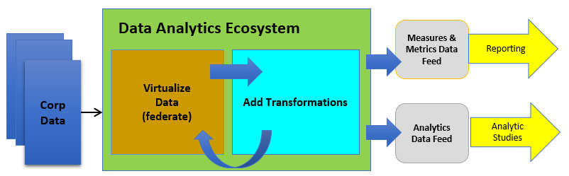

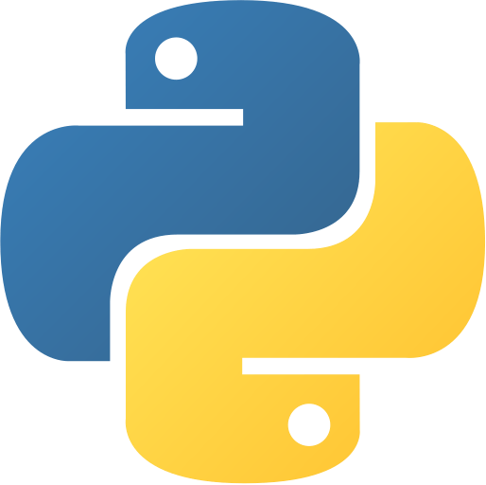
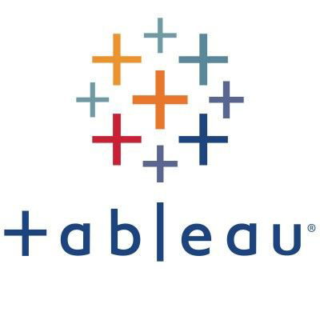

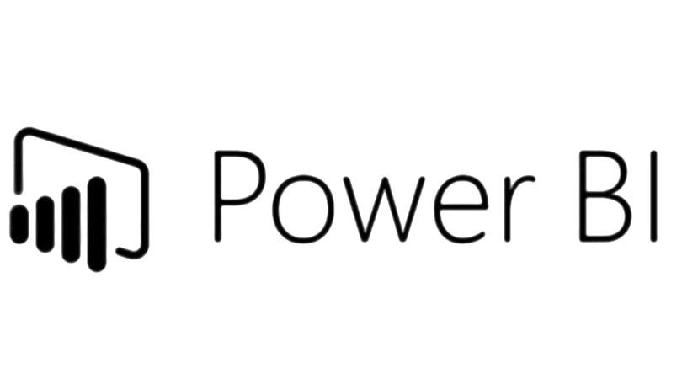

Infrastructure – Architectural Components
Current Infrastructure:
Data Pipeline – Tibco Data Virtualization
CKAN – Portal and Catalog ecosystem
Docker – containerized environment
GitLab – Code Repository
Confluence Wiki – Documentation
Visualizations – Shiny Server, Tableau Server, and PowerBI
Model Execution – Microsoft Machine Learning Server
Search – Solr (integrated with CKAN)
Languages – Python and R
Currently deployed:
CKAN w/branding
Populated data pipeline (datasets)
Populated metadata into catalog
Supports various package types (datasets, models, visualizations, tools, applications)

Slide 10

Patrick Carlson
Patrick Carlson
pcarlso@sandia.gov
http://carlsonp.github.io/
Patrick Carlson is a PhD graduate in Human-Computer Interaction (HCI) with a Bachelor of Arts in Computer Science and Psychology. He has worked at Sandia as a Data Scientist for the past two years. He’s interested in the intersection of humans and technology such as user-experience (UX), user-centered design (UCD), and visualizations. In addition, he’s interested in the technical aspects of Data Science.

Slide 11
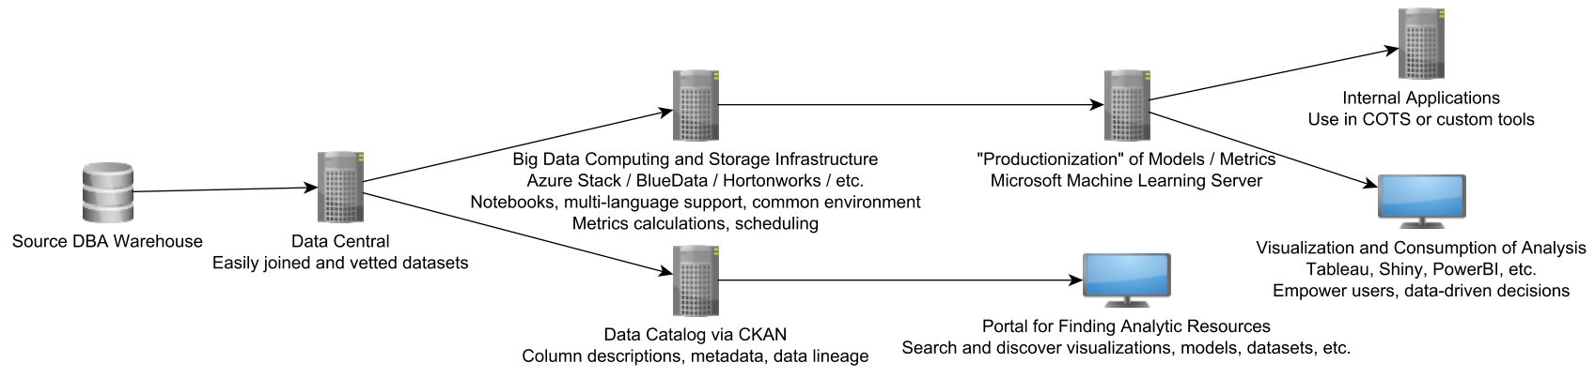
Drilling Down – Beyond Data Pipelines
Productionizing Machine Learning (FY19 and FY20)
Azure Stack / Blue Data / Hortonworks / etc.
Server environment with common libraries
Multi-Language support (R / Python / etc.)
Team Collaboration (FY20)
Notebooks for analysis and exploration
Server environment to access common libraries
Access to common server tools (for visualization, modeling, documentation, etc.)

Slide 12
“Productionization” of Machine Learning (Model Marketplace)
The movement from research & development structured machine learning code to “productionizing” it for general consumption by users or programmatic means is one of the main initiatives. (could be exposed as an API, code, or data)
Purpose:
Moving from ad-hoc desktop R&D products to higher impact products used by larger audiences
Predictable / reusable streams of quality data
Ability to integrate trained models into non-traditional functional areas
Results in an increased use of data and timeliness in the “data-driven decision-making” process

Slide 13
Team Collaboration
An environment and consistent set of tools where teams can jointly development models and perform analysis using a consistent set of corporate tools and libraries, as well as, add new project-level data sources. Results can be productionized and move to the Model Marketplace.
Purpose:
Get review and feedback from other data scientists
Share knowledge and discover alternative solutions and approaches
Provide a place to do exploration using new dataset instead of your desktop
Have data and tools available in a single location
Allows for better integration between data engineers and data scientist
Security – less data leakage because a common single environment
Model result replication – with Docker and frozen library versions
Results in improved communication, community development, and model re-use

Slide 14
Roles Necessary for Productionization
Ad Hoc
Theoretical
Makers
Productionization
Users and Decision Makers
Data Scientists
Statisticians
Data Analysts
Data Engineers
Machine Learning Engineers
Developers
UI/UX
Testers
Sys Admins
Database Administrators
Data Governance
Infrastructure Engineers
Managers / Leadership
Members of the Workforce
Chief Data Officer
“Thinkers” “Do-ers” “Deciders”

Slide 15
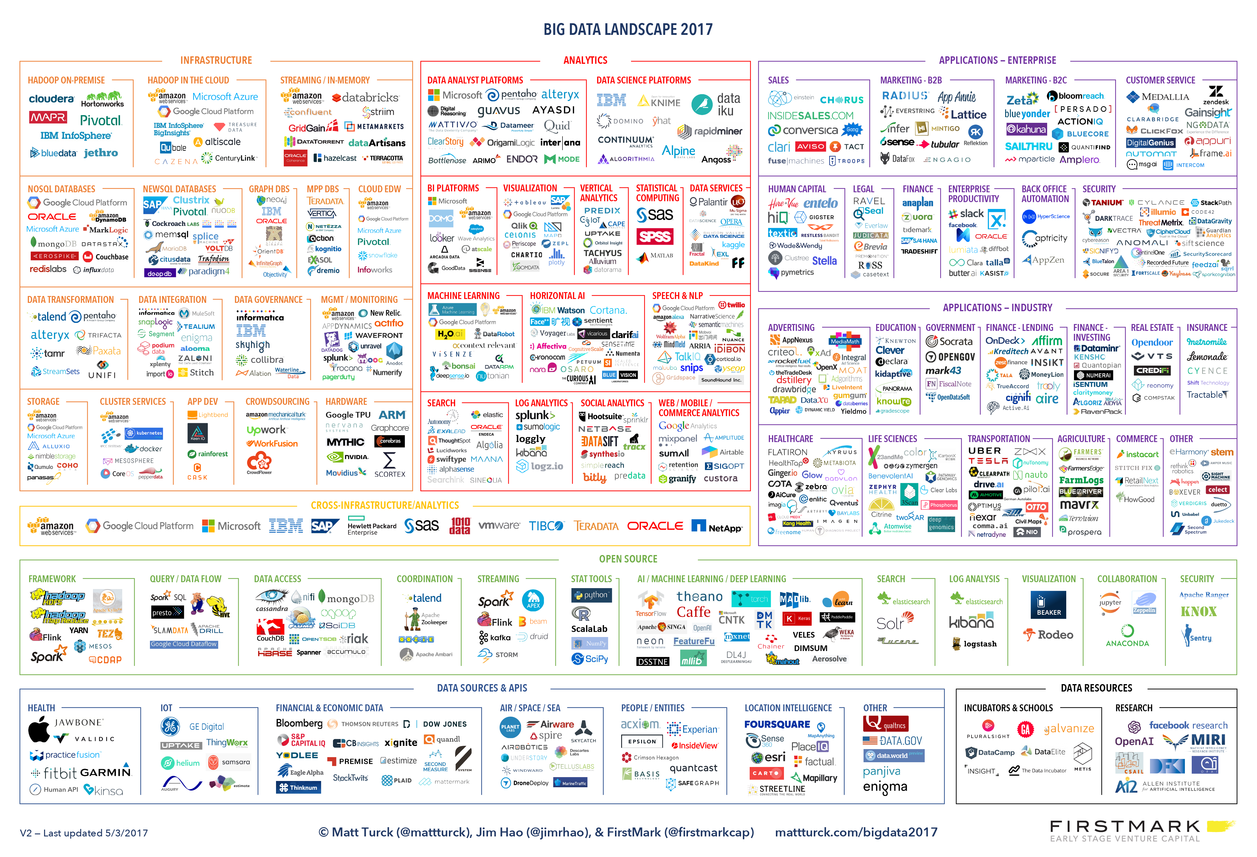
Wading Through the Large Number of Tools
http://anthonyhuntley.com/data-science-tools/

Slide 16
Tooling and Infrastructure Landscape
Key Takeaways From Previous Slide:
There is no one tool or system that will solve all your problems
Wide variety of architectures and implementations in industry
Our evaluations of systems were based on existing infrastructure and collaboration with other Sandia organizations

Slide 17
Design and Architecture Considerations
Cloud friendly, helps with scalability, future-proofing
Cloud costs, pay for what you use or provision
Cloud is not a “replacement” for infrastructure, it’s a more agile way of developing and deploying systems
Supports structured and unstructured data
Allows for code-based data engineering and model development throughout entire pipeline
Authoring / development environment (Notebook)
Pick architecture for big data now
Decide on common languages (Python, R, etc.), kernels can help with this
Use a User-Centered Design (UCD) approach, solicit feedback from all roles
Kubernetes and container orchestration and management solutions
Vendor lock-in
Notes:
Cloud Adoption Framework example from AWS presentation

Slide 18
Systems Evaluated
Microsoft Azure Stack
Machine Learning Server
Machine Learning Services
Data Science Virtual Machines
Hortonworks Data Platform (HDP 3.0) (recent merger with Cloudera)
DataBricks
BlueData
RapidMiner
Custom developed (via Docker)
Kaggle.com (not available for purchase, as an example)

Slide 19
System Comparison
 | Productionization | Computation + Scalability | Cloud Friendly | Collaboration | Integration
Microsoft Azure Stack | Yes | Yes | Yes | Yes | Partial
HDP | Yes | Yes | Yes | Yes | Yes
DataBricks | Yes | Yes | Yes | Yes | Yes
BlueData | TBD | TBD | TBD | TBD | TBD
RapidMiner | Yes | Yes | Yes | Partial | Yes
Custom (Docker) | Yes | Yes | Yes | Yes | Yes
Azure Stack – leverages our on-prem hardware
HDP – large ecosystem of services, supported by HPC
DataBricks – live collaboration in notebooks w/multiple users
BlueData – containerized solution, supported by HPC
RapidMiner – drag-and-drop authoring environment, deployed for one year
Custom (Docker) – full control, pick software we like

Slide 20
Future Next Steps
By end of FY19
Deploy prototype of Model Marketplace using existing tools (Microsoft Machine Learning Server, CKAN, etc.)
By end of FY20
Select and deploy additional tooling and infrastructure
Re-deploy a more robust Model Marketplace using new tooling and infrastructure
Deploy team collaboration environment to support the Data Science community across Sandia

Slide 21
Questions to Ask
How can you create a multi-disciplinary team that balances research, software engineering best practices, performance, productionization, and more?
Operations & Maintenance (O&M), who will “own” and manage these systems?
How will you structure your team?
How will you delineate roles and responsibilities?
How will these new tools and systems come online? What impact will it have to your existing systems?
How will you communicate your systems capabilities?
Data Sciences – Community of Practice (CoP)

Slide 22
Challenges You Might Face or Things to Consider
Data “silo-ing” and “ownership”
Do you have a Data Sciences champion? Do you have a Chief Data Officer? Do you need one?
Do you have a data catalog? Do Data Scientists get raw or transformed data?
Do you have an organizational structure that promotes common data goals?
Do you have an Enterprise Architectures? (data management, data governance, analytics, cloud, etc.)
What is your Data Science maturity level? (data used in decision-making process)

Slide 23
Questions?

